Slide 1
Capital Gains & Losses (Including Sale of Home)
Pub 17 Chapters 13-16
Pub 4012 Tab D
(Federal 1040-Line 13)
(NJ 1040-Line 18)
Notes:
1

Slide 2
Introduction
What is a capital gain (loss)?
It’s your profit (loss) when you sell a capital asset for more (less) than you invested in it
Capital assets
Generally, nonbusiness assets such as securities (e.g. - stocks, bonds, mutual funds)
NOT a capital asset
Inventory
Property used as a rental or in a business
Copyright, a literary, musical, or artistic composition letter, memo or similar
“Sort-of” capital assets
Homes and other personal use items (e.g. boat, jewelry, car, etc.)
Considered capital assets for gains (taxed)
Considered personal assets for losses (not deductible)

Slide 3
Stock Sales – Schedule D
Key elements of stock sale
When was it bought?
When was it sold?
What was the sales price?
What was the cost basis?
Notes:
3

Slide 4
Stock Sales – Capital Gains
TaxSlayer does the following:
Determines whether long/short term
Calculates taxable gain/loss
Calculates tax liability
Calculates capital loss carryover to next year
Notes:
Long-term capital gains rates for 2016
0% - if in 10% or 15% tax bracket
15% - if in 25%-35% tax bracket
20% - if in 39.6% tax bracket
4

Slide 5
Sales Price
Obtained from end-of-year tax statement:
1099 B - Proceeds From Broker & Barter Exchange Transactions
1099 Consolidated Statement
May be reported as gross proceeds or net proceeds (less commissions)
Notes:
5

Slide 6
Cost Basis
Cost basis is cost plus commission on purchase
Use cost basis of First In First Out (FIFO) shares purchased unless specified in writing before sale
Original basis is adjusted by any stock split or non-taxable dividend (return of principal)
Cost basis of taxable stock dividends & Dividend Reinvestments (DRIP) is the price of the stock on distribution date
Notes:
6

Slide 7
Cost Basis
(cont’d)
Adjusted cost basis & short/long-term status for “covered securities” must be reported on 1099-B
Securities are “covered” if they were acquired after:
1/1/2011 Stocks (including REITs, ADRs, & some ETFs)
1/1/2012 Mutual funds, stock DRIPS, rest of ETFs
1/1/2013 Notes, bonds, options, commodities
If securities were purchased prior to required coverage date, taxpayer must provide cost basis
Tax law allows use of average of stock price during approximate period of purchase, if no other records are available (must be provided by taxpayer)
Notes:
“Covered” securities were developed to standardize the regulations and filings of securities in the United States
Financial institutions must provide cost basis for “Covered” Securities
7

Slide 8
Basis other than Cost
Inherited in 2010 - tax law changed for that one year
Out of Scope (unless provided by executor)
Gifts received
Out of Scope
Average of stock price
In scope only if client provides average price
Out of Scope if counselor must calculate
Taxpayer cannot provide information
In scope only if client agrees to take a zero cost basis
Employee stock options (ESOP)
Out of Scope
Notes:
Inherited capital gains are always considered long-term gains
Law was changed for assets inherited in 2010 and then changed back in 2011. That is why assets inherited in 2010 are Out of Scope unless the cost is specifically supplied by executor of estate
8

Slide 9
Adjusted Basis
Events can change the per share cost basis
Stock splits
Buy 100 shares @ $10 per share, splits 2 for 1
Now have 200 shares @ $5 per share
Dividend reinvestments
Buy additional shares at current price
Example:
100 shares @ $10
5 shares @ $20
3 shares @ $18
Notes:
9

Slide 10
Sales Commissions
Commission paid will affect the gain/loss
If 1099-B reports sale as net
No adjustment to gain/loss is needed
If 1099-B reports sale as gross
Adjustment to reduce gain/add to loss is needed to reflect commission paid
Use adjustment explanation “Form 1099-B with Basis in Box 3 is Incorrect & Correct Basis is Lower or Higher“ from TaxSlayer drop-down menu and enter adjustment as a negative number to reduce profit/add to loss
Notes:
10

Slide 11
1099-B Proceeds from Broker and Barter Exchange Transactions
Date sold
2016
Date acquired
Cost
Box checked for non-covered
securities; then boxes 1b, 3, 5, 8 may be blank
S/T or L/T
Notes:
If Box 6 is checked, the security is “non-covered.” Thus, Boxes 1b, 3, 5, & 8 may be blank
11

Slide 12
Holding Period - Short Term (ST) vs. Long Term (LT)
Stock held one year or less is short term
Begin counting the day after the trade date and include the day of sale
Taxed at regular tax rates
Stock held more than one year is long term
Taxed at capital gains rates
Notes:
12

Slide 13
Holding Period - May Need to Determine Long Term vs. Short Term in Special Cases
Stock Dividends & DRIP
Shares acquired in tax-free stock dividend or stock split have same holding period as original shares
Holding period for taxable stock dividends & Dividend Reinvestments (DRIP) are based on the date of declaration
They do not revert to the holding period of the original stock
Notes:
13

Slide 14
Holding Period - May Need to Determine Long Term vs. Short Term in Special Cases
(cont’d)
If sale of all shares bought on various dates, at different prices (multiple blocks), select “Alternate Option” for Date Acquired
Choose either “Various-short term” or “Various-long term” from drop-down menu
Record sale as two separate transactions if some shares are short term and some are long term
Inherited shares are considered long term
Choose “Inherited-long term” from drop-down menu (does not apply to shares inherited in 2010)
Notes:
14

Slide 15
Tax Liability Net Gain
If there is both net long-term & net short-term gain:
Net long-term gain will be taxed at the lower capital gain rate
Net short-term gain will be taxed at the higher ordinary income tax rate
If net long-term gain exceeds net short-term loss, the net gain is taxed at capital gain rates (TaxSlayer calculates)
Notes:
15

Slide 16
Capital Gains Tax Rates
Short-term capital gains taxed at ordinary income tax rate for tax bracket
Long-Term Capital Gains rates:
Tax Bracket Capital Gains Tax Rate
10% or 15% 0%
25% - 35% 15%
39.6% 20%
Notes:
16

Slide 17
Tax Liability Net Loss
Net loss can offset all gains, plus
Up to $3,000 can be used to reduce other taxable income in the current tax year ($1,500 if MFS)
The loss amount in excess of $3,000 (or $1,500 if MFS) is carried forward to the next tax year
NJ only allows taxpayer to use capital losses to offset capital gains in the same year. No net capital loss is permitted
Notes:
17

Slide 18
Capital Loss Carryover
Check prior year Schedule D or related worksheet to determine carryover loss
Carryover losses keep their short-term or long-term classification
Carryover losses are combined with the gains and losses that actually occur in the current year
Up to $3,000 ($1,500 if MFS) loss offsets other income on current year return. Rest of loss is carried forward to next year
No limit to how many times a loss can be carried forward
No capital loss carryover allowed in NJ
Notes:
18

Slide 19
TS - Capital Loss Carryover From Last Year to This Year Federal Section \ Income \ Enter Myself \ Capital Gain and Losses (Schedule D) \ Other Capital Gains Data
Enter short-term carryover from last tax year to this year
Enter long-term carryover loss from last tax year to this year

Slide 20
TS – 1040 Line 13 - Maximum Capital Loss on Current Year Return
Notes:
Up to $3,000 of capital losses can be deducted against other income on 1040 Line 13

Slide 21
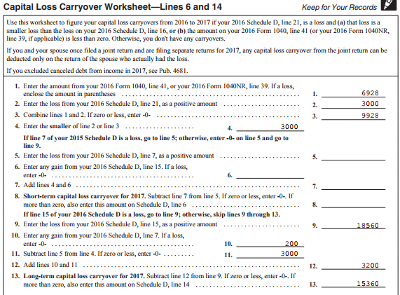
TS - Capital Loss Carryover Worksheet From This Year to Next Year
Required For Next Year’s Returns
Short-term carryover from current year to next year
Long-term carryover from this year to next year
Notes:
When there is a capital loss to carry over from this year to next year, TaxSlayer will populate Lines 8 & 13 of the Capital Loss Carryover Worksheet in current year; needed for preparing following year’s return
21

Slide 22
Capital Gain Distributions
These distributions result when mutual funds that sold stock pass resulting gains to taxpayer each year
Result from sales within the mutual fund; does not matter if taxpayer sold the fund itself or still owns it
Treated as long-term capital gain. Enter on TaxSlayer Dividend Income screen
If Sch D required for other transactions, will flow to Sch D, then to 1040 line 13
If these are the only capital gains, no Schedule D required and will flow directly to 1040 line 13
Reported on 1099-DIV Box 2a or Broker’s Consolidated Statement
Notes:
Explain that you may have received capital gain distributions form a mutual fund even if you do not sell anything. These distributions are based on gains that the mutual fund receives on sales within the fund. Mutual funds are required by law to pass those gains on to the shareholders
22

Slide 23
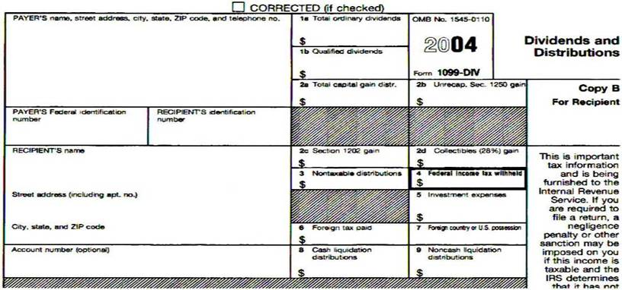
1099-DIV Dividends & Distributions
2016
Notes:
Sample 1099-DIV showing where the Capital Gains Distribution would be reported
23

Slide 24
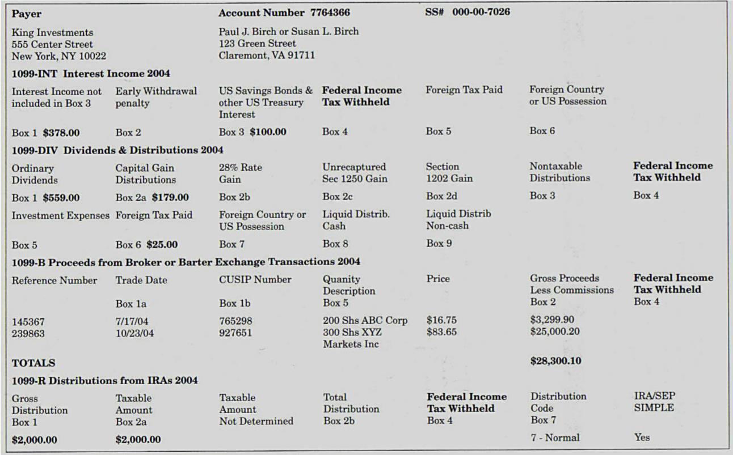
1099 Consolidated Statement
Notes:
1099 Consolidated Statement showing where the Capital Gains Distribution would be reported
24

Slide 25
Demutualization
Demutualization occurs when insurance company is changed from a “mutual company” to a “stock company” & issues stock or cash to policyholders in the new company
Per IRS, cost basis of stock issued is $0
When sold, stock is always long term
Several court cases have issued different rulings on cost basis. Taxability varies depending on the type of transaction. If amount is significant and affects the tax owed, the taxpayer may benefit by going to a paid preparer
Notes:
Demutualization:
The process through which a member-owned company becomes shareholder-owned
Frequently this is a step toward the initial public offering (IPO) of a company
25

Slide 26
Schedule K-1 Capital Gains & Losses
End-of-year tax statement:
Schedule K-1 Partner’s Share of Income shows
Net short-term capital gain/loss
Net long-term capital gain/loss
Enter K-1 capital gains/losses in Federal section \ Income \ Enter Myself \ Other Income \ K-1 Earnings
Choose specific form that includes the K-1 income
Enter on the net short- or long-term capital gains/losses lines
Notes:
Schedule K-1 reports each shareholder's pro-rated share of net income or loss
Only in scope transactions/financials from K-1 are:
Interest
Dividends
Capital Gains
Royalties
26

Slide 27
Sample Schedule K-1
2016
Note: K-1s may vary in format
Notes:
Sample K-1 showing where short-term & long-term capital gains would be reported
27

Slide 28
Wash Sales
Definition of a wash sale:
A stock sold by taxpayer at a loss and substantially equivalent stock is purchased within 30 days (either before or after). The loss is not deductible
1099-B, brokerage statement will show:
Original sales price in Box 2 & cost in Box 3
Wash Sales Disallowed in Box 5
Enter as an adjustment to a capital gain/loss
Choose “Nondeductible Loss from a Wash Sale” as the adjustment explanation
Enter as a positive number to increase profit/reduce loss
Add disallowed loss to cost basis of new stock bought
Notes:
28

Slide 29
TS - Entering Capital Gain/Loss Transactions
Enter all gain/loss info in Federal Section \ Income \ Enter Myself \ Capital Gain and Losses (Schedule D) \ Capital Gains and Loss Items
TaxSlayer will transfer info to appropriate Forms 8949, Schedule D, & 1040
Notes:
29

Slide 30
Capital Gains/Losses Transactions Federal Section \ Income \ Enter Myself \ Capital Gain and Losses (Schedule D) \ Capital Gains and Loss Items
Date acquired
Date sold
Sales price
Cost basis reported to IRS or not
Cost basis
Adjustment amount
Adjustment reason
Notes:
30

Slide 31
Capital Gains/Loss Screen – TS Tips
Description of property - include # of shares in description (e.g. - 100 sh Microtex )
Date acquired (from 1099-B Box 1-b or taxpayer)
If shares of same asset were purchased on multiple dates
Click on “Alternate Option”
Choose “Various – Short Term” or “Various – Long Term”
If asset inherited prior to 1/1/2010 & after 12/31/2010
Click on “Alternate Option”
Choose “Inherited – Long Term” (inherited always long term)
Special rules for sales of assets inherited in 2010 - Out of Scope unless cost provided by executor
Notes:
Student Reference Only
31

Slide 32
Capital Gains/Loss Screen – TS Tips
(cont’d)
Date sold (from 1099-B Box 1a)
Sales Price (from 1099-B Box 2)
Cost (from 1099-B Box 3, taxpayer, internet)
Adjustment to Gain/Loss
Gain/Loss adjustment explanation
Refer to Pub 4012 Page D-26 for adjustment reasons and associated explanation to choose
TaxSlayer will populate appropriate adjustment code on Form 8949
Notes:
Student Reference Only
32

Slide 33
Form 8949
After transactions are entered in Capital Gain/Loss section, TaxSlayer will transfer transactions to Form 8949
Up to six separate 8949 pages may be populated:
Code A - S/T with cost reported to IRS
Code B - S/T with cost not reported to IRS
Code C - S/T not reported on 1099-B
Code D - L/T with cost reported to IRS
Code E - L/T with cost not reported to IRS
Code F - L/T not reported on 1099-B
Notes:
33

Slide 34
TS - Sales & Other Dispositions of Capital Assets – Form 8949 for 1099 Code A (S/T, Cost Reported)
All 1099 code A transactions
Notes:
34

Slide 35
TS - Sales & Other Dispositions of Capital Assets – Form 8949 for 1099 Code D (L/T, Cost Reported)
All 1099 Code D transactions
Notes:
35

Slide 36
TS - Sales & Other Dispositions of Capital Assets – Form 8949 for 1099 Code E (L/T, Cost Not Reported)
All 1099 Code E transactions
Notes:
36

Slide 37
Capital Gains & Losses on Schedule D
TaxSlayer transfers data from 8949s to Schedule D
Schedule D shows summary lines of transferred totals
Line 1b – S/T with Box A checked in Part I on 8949
Line 2 – S/T with Box B checked in Part I on 8949
Line 3 – S/T with Box C checked in Part I on 8949
Line 8b – L/T with Box D checked in Part II on 8949
Line 9 – L/T with Box E checked in Part II on 8949
Line 10 – L/T with Box F checked in Part II on 8949
Notes:
37

Slide 38
Capital Gains & Losses on Schedule D
(cont’d)
TaxSlayer will transfer any capital gains distributions from 1099-DIV to Sch D Line 13
Short-term/long-term capital loss carryover from last year is transferred to Sch D Part I Line 6/Part II Line 14
TaxSlayer transfers net capital gain/loss to 1040 Line 13
NOTE: Loss on 1040 Line 13 is capped at $3,000. If loss is greater than that, TaxSlayer creates Capital Loss Carryover Worksheet
Notes:
38

Slide 39
TS - Schedule D Part I – Short-Term Capital Gains/Losses
Totals from 8949 Code A transactions
S/T capital loss carryover from prior year
Net S/T capital gain
Notes:
TaxSlayer transfers short-term capital gains/losses info from Form 8949s to Schedule D Lines 1 – 3
Line 1b - S/T totals with Box A checked in Part I on 8949
Line 2 - S/T totals with Box B checked in Part I on 8949
Line 3 - S/T totals with Box C checked in Part I on 8949
39

Slide 40
TS - Schedule D Part II – Long-Term Capital Gains/Losses
Totals from 8949 Code D transactions
Totals from 8949 Code E transactions
Capital gains distributions from1099-DIV
L/T capital loss carryover from prior year
Net L/T capital loss
Notes:
TaxSlayer transfers long-term capital gains/losses info from Form 8949s to Schedule D Lines 8 – 10
Line 8b – L/T totals with Box D checked in Part II on 8949
Line 9 - L/T totals with Box E checked in Part II on 8949
Line 10 - L/T totals with Box F checked in Part II on 8949
40

Slide 41
TS - Capital Gain/Loss – 1040 Line 13
Maximum capital loss in current year
Notes:
TaxSlayer transfers total from Schedule D Part III to 1040 Line 13
41

Slide 42
TS – Capital Loss Carryover Worksheet
Long-term capital loss carryover to next year
Notes:
42

Slide 43
TS - Qualified Dividends and Capital Gains Tax Worksheet – Tax on All Taxable Income
TaxSlayer calculates tax on all taxable income
Notes:
TaxSlayer calculates the tax on all taxable income on the Qualified Dividends and Capital Gains Tax Worksheet
43

Slide 44
TS - Tax – 1040 Line 44
TaxSlayer transfers from Qualified Dividends
and Capital Gains Tax Worksheet
Notes:
TaxSlayer transfers total tax due from the Qualified Dividends and Capital Gains Tax Worksheet to 1040 Line 44
44

Slide 45
Consolidating Capital Gains Transactions on Capital Gains/Loss Screen
Pub 4012 Page D-25
When entering capital gains transactions on the Capital Gains/Loss screen, you can consolidate multiple transactions on single line based on the four 8949 categories A, B, D, E
Code A & D: Enter total of all short- or long-term transactions where cost basis was reported to IRS
Choose “Reporting Multiple Transactions on a Single Row” as an adjustment reason. TaxSlayer will assign adjustment code M
Code B & E: Enter individual transactions unless have ERO approval
Will require extra paperwork and copies of brokerage statement
Refer to Pub 4012 Page D-25 or TaxPrep4Free.org Special Topics. The documents are:
“Consolidating Capital Gains” (for the preparer)
“Form 8453 Instructions” (for the ERO)
Notes:
You are allowed to consolidate the transactions into subtotals based on the 1099 codes used on Form 8949 (i.e. – Codes A, B, D, E). Then you enter the subtotals on the Capital Gains/Loss screen and use “Reporting Multiple Transactions on a Single Row” as the adjustment reason
When you consolidate transactions for Code A or D, no extra paperwork required.
When you consolidate transactions for Code B or E, you must send a copy of the brokerage statement plus all 8949s to the IRS along with Form 8453. See your ERO for help in mailing documents

Slide 46
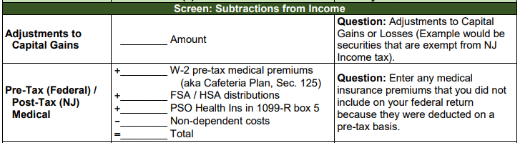
Non-Taxable NJ Securities
Gains on certain NJ Securities are exempt from NJ tax even though subject to Federal capital gains tax
See NJ Bulletin GIT-5 for a list of these securities (link from TaxPrep4Free.org Preparer page)
The NJ return has to be adjusted when this situation occurs
Capture exempt capital gains amount in NJ Checklist Subtractions from Income section for later entry in TaxSlayer State section

Slide 47
NJ Adjustment to Capital Gains
Subtract out amount of capital gains on NJ
securities that are tax exempt

Slide 48
NJ Sch B
Subtract out amount of capital gains on NJ
securities that are tax exempt

Slide 49
Sale of a Home What is Considered a “Main” Home?
Determined by facts – not by choice
Where taxpayer lives most of the time
If taxpayer is living in a rental, the rental might be considered the main home
Other places may qualify (house, boat, mobile home, apartment, condo, etc.)
Land sale does not qualify
Notes:
Reverse Mortgages are a non-tax event
Counselor does nothing
Related fees could impact cost basis when home is sold
If selling a non-main residence home, the loss can be considered a capital asset sale with a loss, entered on Capital Gains/Loss transaction worksheet
49

Slide 50
Home Sale Terms
Selling Price - includes all monies received plus any mortgages or other debts taken over by the buyer (does not include amounts received for personal property sold with home--e.g. furniture or appliances)
Amount Realized - the selling price minus selling expenses
Selling Expenses - commission, advertising, legal fees, loan charges paid by seller
Basis – actual cost if bought or built
Cost basis for property inherited in 2010 is lower of Fair Market Value at death or decedent’s cost basis Out of Scope
Adjusted Basis - the original cost plus/minus any increase or decrease to original basis (additions, eligible improvements)
Tax statement – Form 1099-S - Proceeds from Real Estate Transaction may be issued
Notes:
Can only adjust basis for additions & improvements that have a useful life of more than one year
50

Slide 51
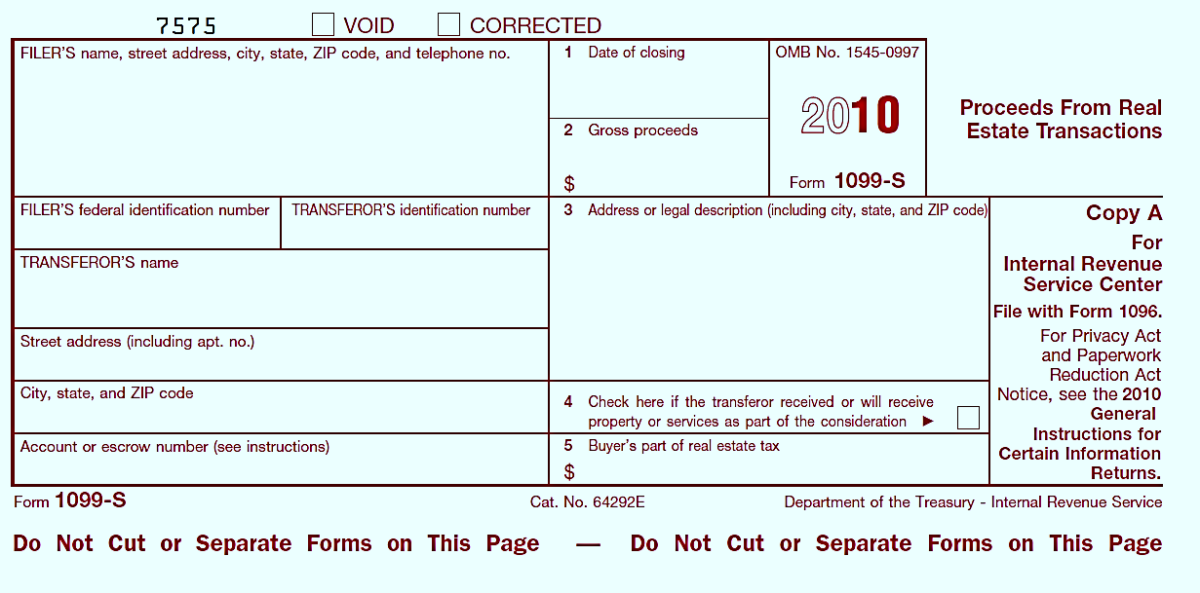
1099-S Proceeds From Real Estate Transaction
Includes cash or notes received for property
2016
Checked if other services or property is received as payment *
Note: 1099-S may not be provided if total gain can be excluded or if gains/loss from sale of other services or property are considered
Notes:
51

Slide 52
Calculating Home Sale Gain/Loss
Amount Realized
minus Adjusted Basis
==============
Gain or Loss
Loss on sale of main home cannot be deducted & is not reported on tax return (unless 1099-S is issued – covered later)
Notes:
Remember:
Amount realized = selling price minus selling expenses
Adjusted basis = original cost plus/minus any changes to basis
52

Slide 53
House Sale Gain Exclusion Ownership & Use Tests
Taxpayer who sold a qualified main home this year may qualify to exclude part or all of the gain from income*
Must meet ownership & use tests (during the 5-year period ending on the date of sale)
Ownership test - must have owned the home for at least 2 years AND
Use test - must have lived in the home as your main home for at least 2 years
Do not have to be the same 2 years for ownership & use tests
*Sale of home that is not “main home” is treated like sale of any capital asset.
Exclusion does not apply
Notes:
53

Slide 54
Calculate House Sale Gain Exclusion
Single homeowner can exclude up to $250,000 of gain from sale of main home
Unmarried surviving spouse can exclude $500,000 if sale occurs within 2 years of spouse’s death
Married couple can exclude up to $500,000 of gain, if:
Filed a joint return
Both individuals meet the use test
If only one meets use test, refer to Pub 17 – Sale of Home
Either or both meet the ownership test
Neither individual excluded gain in the 2 years before the current sale
Notes:
Exclusion can be used more than once in your life as long as it wasn’t taken in last 2 years
Pub 523 states if home was owned jointly and one spouse dies, decedent’s basis portion of home is adjusted to Fair Market Value at time of death. Surviving spouse’s basis remains the same. Total basis is the sum of these two numbers
54

Slide 55
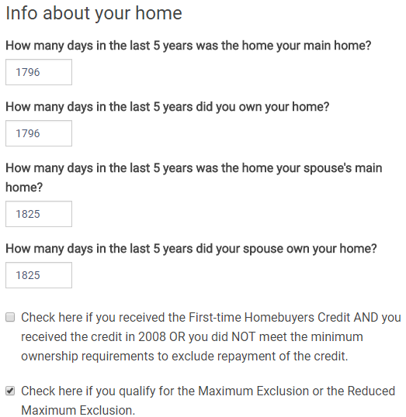
TS - Capital Gain on Sale of Home Federal Section \ Income \ Enter Myself \ Capital Gain and Losses (Schedule D) \ Sale of Main Home Worksheet \ Basic Info about Home
Qualifies for Exclusion (Reduced Maximum Exclusion is Out of Scope)
Notes:
55

Slide 56
TS - Capital Gain on Sale of Home Federal Section \ Income \ Enter Myself \ Capital Gain and Losses (Schedule D) \ Sale of Main Home Worksheet \ Adjustments to Sale
Notes:
56

Slide 57
TS - Capital Gain on Sale of Home – Form 8949
Profit that can be excluded
(exclusion + selling expenses)
Cost basis + adjustments
Taxable gain
Notes:
57

Slide 58
TS - Capital Gain on Sale of Home – Schedule D
B
Notes:
Note: Sale of a second house is a regular sale of a capital asset, and home gain exclusion does not apply
58

Slide 59
Gain/Loss on Sale of House – TS Tips
If all of gain can be excluded, do not enter data into TaxSlayer unless 1099-S was issued
If sale results in a loss, do not enter data unless 1099-S was issued. Loss on personal property is not deductible
If all of gain cannot be excluded, report taxable gain on Schedule D
Enter data in Federal Section \ Income \ Enter Myself \ Capital Gain and Losses (Schedule D) \ Sale of Main Home Worksheet
Enter “Basic Information about Home”
Enter “Adjustments to the Sale,” including purchase fees and general adjustments
TaxSlayer populates Form 8949 and Schedule D
Code C or F - no 1099-B received
Adjustment code column – H (exclusion of gain on main home)
Adjustments to Gain or Loss amount – amount of gain that can be excluded as a negative number
Notes:
59

Slide 60
When 1099-S is Issued
1099-S usually not issued if total gain can be excluded or if sale results in a loss
If 1099-S is issued anyway and total gain is excludable :
Enter data on Sale of Main Home Worksheet to notify IRS that gain was excludable
Notes:
60

Slide 61
When 1099-S is Issued
Pub 4012 Tab D
(cont’d)
If home sale results in a loss, which is nondeductible, TaxSlayer does not generate any 8949 or Schedule D transaction. Enter sale information as follows:
Enter the appropriate home information on the Sale of Main Home Worksheet
Create a new capital loss transaction in Federal Section \ Income \ Enter Myself \ Capital Gain and Losses (Schedule D) \ Capital Gains and Loss Items
Enter an adjustment as a positive amount that will zero out the loss
Choose “Nondeductible loss other than a Wash Sale” from the drop-down menu as the adjustment explanation (adjustment code L)
TaxSlayer will then generate the required 8949 and Schedule D transactions
Notes:
61

Slide 62
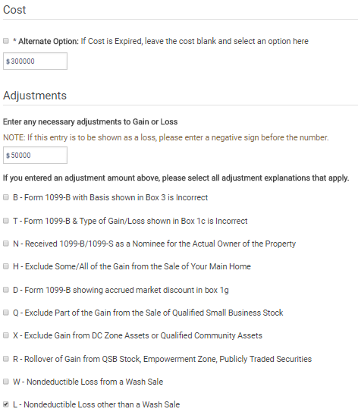
Sale of Home for a Loss (when 1099-S is issued) Federal Section \ Income \ Enter Myself \ Capital Gain and Losses (Schedule D) \ Capital Gains and Loss Items
Adjustment amount to zero out loss
Adjustment reason – Nondeductible loss other than a wash sale
Notes:
62

Slide 63
Sale of Home Reference Material
Pub 4012 Page D-41
Refer to Pub 4012 Page D-28
See TaxPrep4Free.org Preparer page Special Topics document “Sale of Main Home” for detailed information on TaxSlayer entry of a home sale

Slide 64
Out of Scope Situations
Cancellation of debt on mortgage and foreclosure
Sale of business or rental property

